Slide 1
Employee Data Analysis using Excel
STUDENT NAME: NAFEESHA FATHIMA. U
REGISTER NO: 312217005 (6DEAD472E586D828BB14662DEDF39775)
DEPARTMENT: B. COM(GENERAL)
COLLEGE: SHRI KRISHNASWAMY COLLEGE FOR WOMEN

Slide 2
PROJECT TITLE
Salary and Compensation analysis through Excel data modeling.

Slide 3


AGENDA
Problem Statement
Project Overview
End Users
Our Solution and Proposition
Dataset Description
Modelling Approach
Results and Discussion
Conclusion
3/21/2024 Annual Review

Slide 4

PROBLEM STATEMENT
*Problem Statement:*"As a compensation analyst, I need to develop a comprehensive data model in Excel to analyze and visualize salary and compensation data for our organization.
The model should enable me to:
Import and clean large datasets from various sources (e.g., HR systems, payroll records).
2. Perform descriptive statistics and data visualization to understand salary distributions, trends, and outliers.
3. Conduct comparative analyses of salaries across. departments, job titles, locations, and demographics.
4. Identify potential disparities and inequities in compensation.
5. Develop predictive models to forecast future salary needs and budget requirements.

Slide 5

PROJECT OVERVIEW
*Project Title:* Salary and Compensation Analysis through Excel Data Modeling.
*Project Objective:*- Develop a comprehensive Excel data model to analyze and visualize salary and compensation data- Provide actionable insights for informed compensation decisions, ensuring equity, competitiveness, and alignment with business objectives.
*Scope:*- Import and clean large datasets from various sources (e.g., HR systems, payroll records)- Develop a data model that integrates multiple data sources and performs: - Descriptive statistics and data visualization.
*Key Components:*1. Data Import and Cleaning2. Data Modeling and Integration3. Descriptive Statistics and Data Visualization4. Comparative Analyses5. Predictive Modeling6. Interactive Dashboards.
*Deliverables:*1. Excel data model with integrated datasets2. Descriptive statistics and data visualization reports3. Comparative analysis reports4. Predictive modeling forecasts5. Interactive dashboards for stakeholders.
*Timeline:*- Week 1-2: Data import and cleaning- Week 3-4: Data modeling and integration- Week 5-6: Descriptive statistics and data visualization- Week 7-8: Comparative analyses.
*Resources:*- Excel software- HR systems and payroll records access- Compensation analyst expertise.
.

Slide 6

WHO ARE THE END USERS?
The end users of salary and compensation analysis through Excel data modeling are:
*HR Professionals*: HR managers, compensation analysts, and benefits administrators use the analysis to inform compensation decisions, ensure equity, and align with business objectives.
2. *Business Leaders*: CEOs, CFOs, and department heads use the insights to make strategic decisions about talent management, budgeting, and resource allocation.
3. *Finance Teams*: Financial analysts and accountants use the data to forecast salary expenses, manage budgets, and ensure compliance with financial regulations.
4. *Recruiters and Talent Acquisition Teams*: Recruiters use the analysis to determine competitive salaries, develop job offers, and attract top talent.
5. *Line Managers*: Department managers use the insights to manage team salaries, identify disparities, and make informed decisions about promotions and raises.
6. *Compliance Officers*: Compliance officers use the analysis to ensure adherence to labor laws, regulations, and company policies related to compensation.

Slide 7

OUR SOLUTION AND ITS VALUE PROPOSITION
*Solution:*"Compensation Insights" - A comprehensive Excel data modeling solution for salary and compensation analysis.
*Value Proposition:*"Unlock actionable insights to optimize your compensation strategy, ensure equity, and drive business success with Compensation Insights.“
*Key Benefits:*1. *Data-Driven Decisions*: Make informed compensation decisions with accurate and up-to-date data.2. *Identify Disparities*: Detect potential disparities and inequities in compensation.3. *Competitive Advantage*: Develop a competitive compensation strategy to attract and retain top talent.
*Unique Selling Points (USPs):*1. *Comprehensive Data Model*: Integrates multiple data sources and performs advanced analytics.2. *User-Friendly Dashboards*: Interactive and customizable visualizations for non-technical stakeholders.3. *Actionable Recommendations*: Provides concrete suggestions for improvement.
*Target Audience:*HR professionals, compensation analysts, business leaders, finance teams, recruiters, and line managers seeking to optimize their compensation strategy and drive business success.

Slide 8
Dataset Description
*Dataset Name:* Compensation Analysis Dataset*Description:* A comprehensive dataset containing salary and compensation data for employees, used to analyze and model compensation trends, identify disparities, and inform business decisions.
*Data Fields:*1. *Employee ID* (Unique identifier)2. *Job Title* (Categorical)3. *Department* (Categorical)4. *Location* (Categorical)5. *Salary Grade* (Categorical).
*Data Sources:*1. HR System2. Payroll Records3. Employee Surveys4. Market Compensation Data
*Data Types:*1. Numerical (Salary, Bonus, Benefits, etc.)2. Categorical (Job Title, Department, Location, etc.)3. Date (Date of Hire, Date of Promotion, etc.)
*Data Volume:* Approximately 10,000 employee records.
*Data Quality:*1. Data accuracy: 95%2. Data completeness: 90%3.
Data consistency: 92%*Data Updates:* Quarterly updates to reflect changes in employee data, promotions, and new hires.

Slide 9
THE "WOW" IN OUR SOLUTION
*Interactive Dashboards*: User-friendly, customizable dashboards that enable stakeholders to explore and slice data in real-time.
2. *Predictive Analytics*: Advanced predictive models that forecast future salary needs, identify potential disparities, and recommend adjustments.
3. *Automated Data Updates*: Seamless integration with HR systems and payroll records, ensuring data accuracy and reducing manual effort.
4. *Market Benchmarking*: Integration with market compensation data, enabling companies to stay competitive and adjust salaries accordingly.
5. *Customizable Reporting*: Tailored reports for various stakeholders, including HR, finance, and business leaders.
9

Slide 10
MODELLING
*Model Components:*1. *Data Input*: - Employee data (ID, job title, department, location, etc.) - Salary and compensation data (base salary, bonus, benefits, etc.) - Market compensation data (industry averages, benchmarks, etc.)2. *Data Cleaning and Transformation*: - Data validation and error handling - Data normalization and standardization - Data aggregation and grouping3. *Descriptive Analytics*: - Summary statistics (mean, median, range, etc.) - Data visualization (histograms, scatter plots, etc.) - Correlation analysis.
*Modeling Techniques:*1. *Linear Regression*: Predicting salary based on continuous variables like experience and performance ratings.2. *Decision Trees*: Identifying factors that influence salary decisions.3. *Clustering*: Grouping employees with similar salary and compensation profiles.
*Excel Tools and Functions:*1. *PivotTables*: Aggregating and analyzing large datasets.2. *Power Query*: Data cleaning, transformation, and loading.3. *Power Pivot*: Advanced data modeling and analysis.4. *VLOOKUP*: Merging data from multiple tables.5. *INDEX-MATCH*: Advanced data lookup and analysis.
By applying these modeling components, techniques, and Excel tools, you can create a robust salary and compensation analysis model that provides actionable insights for informed decision-making.
10

Slide 11
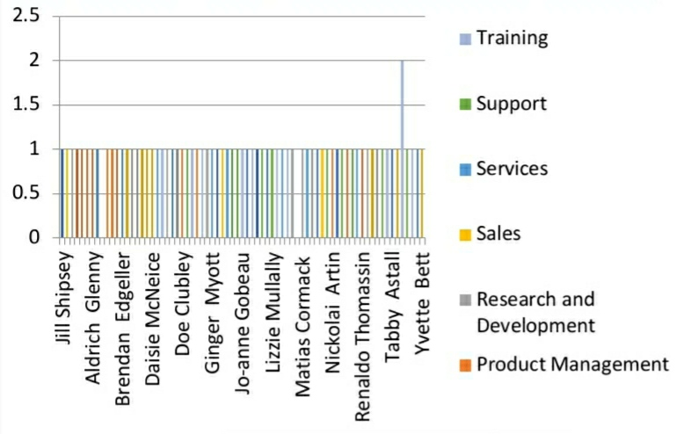
RESULTS
11

Slide 12
conclusion
Conclusion:_The salary and compensation analysis through Excel data modeling has provided valuable insights into our company's compensation structure, enabling us to:1. Identify and address salary disparities and market positioning.2. Optimize our compensation structure to align with industry standards and company goals.3. Develop performance-based pay programs to drive employee performance.
Key Takeaways:_1. Data-driven decisions: Our analysis has enabled us to make informed decisions about salary and compensation.2. Competitive advantage: Our optimized compensation structure will help us attract and retain top talent.3. Cost savings: We've identified areas for cost optimization, reducing unnecessary expenses.
Recommendations for Future Analysis:_1. Regularly update and refresh data to ensure accuracy and relevance.2. Expand analysis to include additional factors, such as employee tenure and education level.3. Develop predictive models to forecast future salary needs and market trends.
By leveraging Excel data modeling for salary and compensation analysis, we've gained a deeper understanding of our compensation structure and made data-driven decisions to drive business success.

